Slide 1
Programing Fundamentals
using
JavaScript

Slide 2
AGENDA

Slide 3
Agenda
Introduction to JavaScript
Programming Fundamentals (Input, Processing Output)
Variables and DataTypes
Operators (Assignment and Arithmetic)
Control Constructs
Selection (Conditionals) - Relational and Logical Operators
Iteration (Loops)
Functions
Arrays

Slide 4
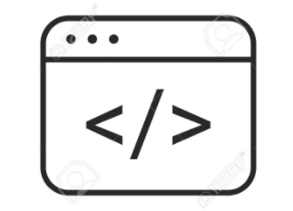
WEB PAGE
A web page is an electronic document. They are files that are stored on a computer that runs software called a web server and retrieve via a program called a browser.

Slide 5
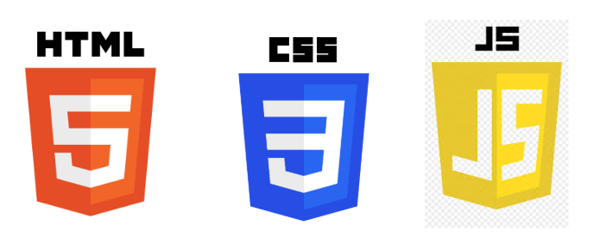
MAIN FRONT-END TECHNOLOGIES

Slide 6

JavaScript
JavaScript is a programming language that is used to add interactivity and functionality to the interface of websites and web applications.

Slide 7

PROGRAMMING FUNDAMENTALS
USING JAVASCRIPT
NO HTML & CSS INVOLVED

Slide 8
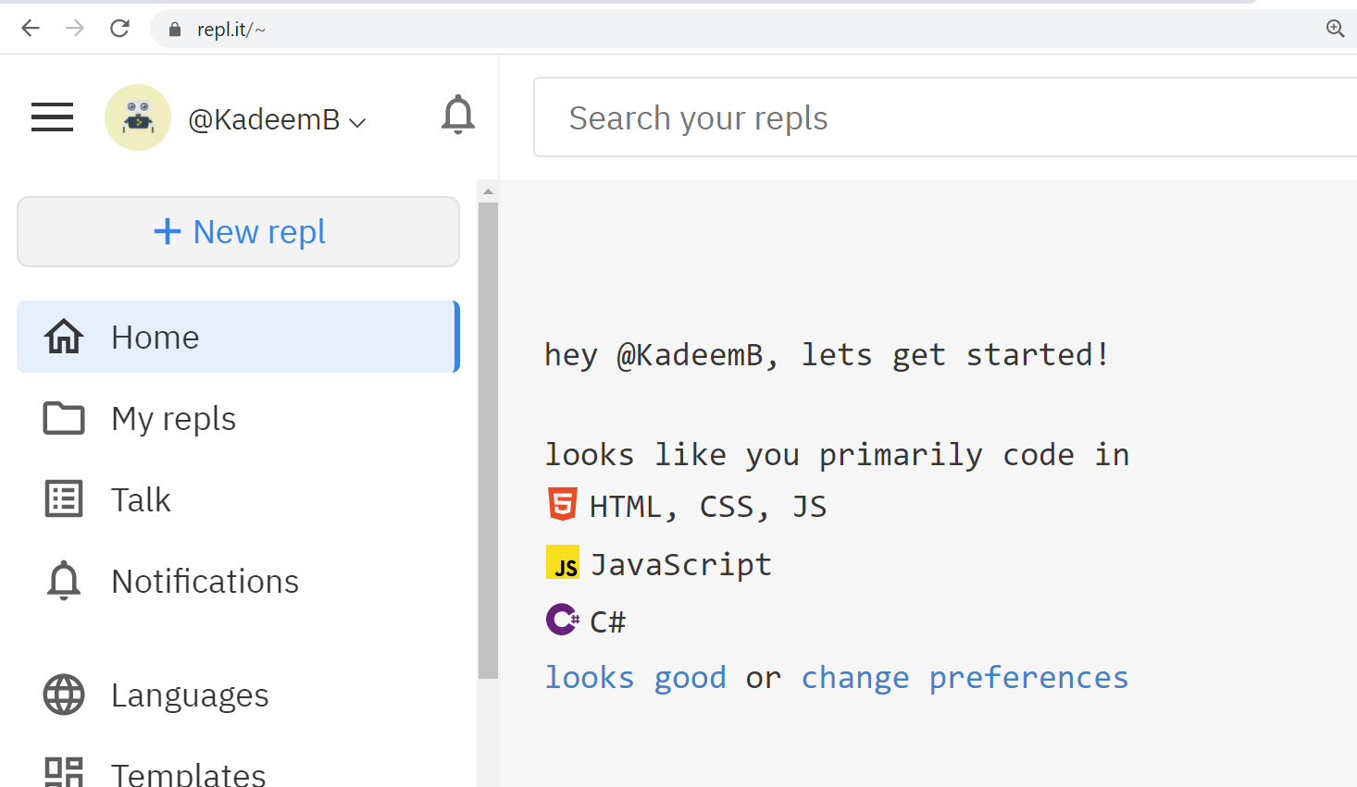
REPL.IT
ations.

Slide 9
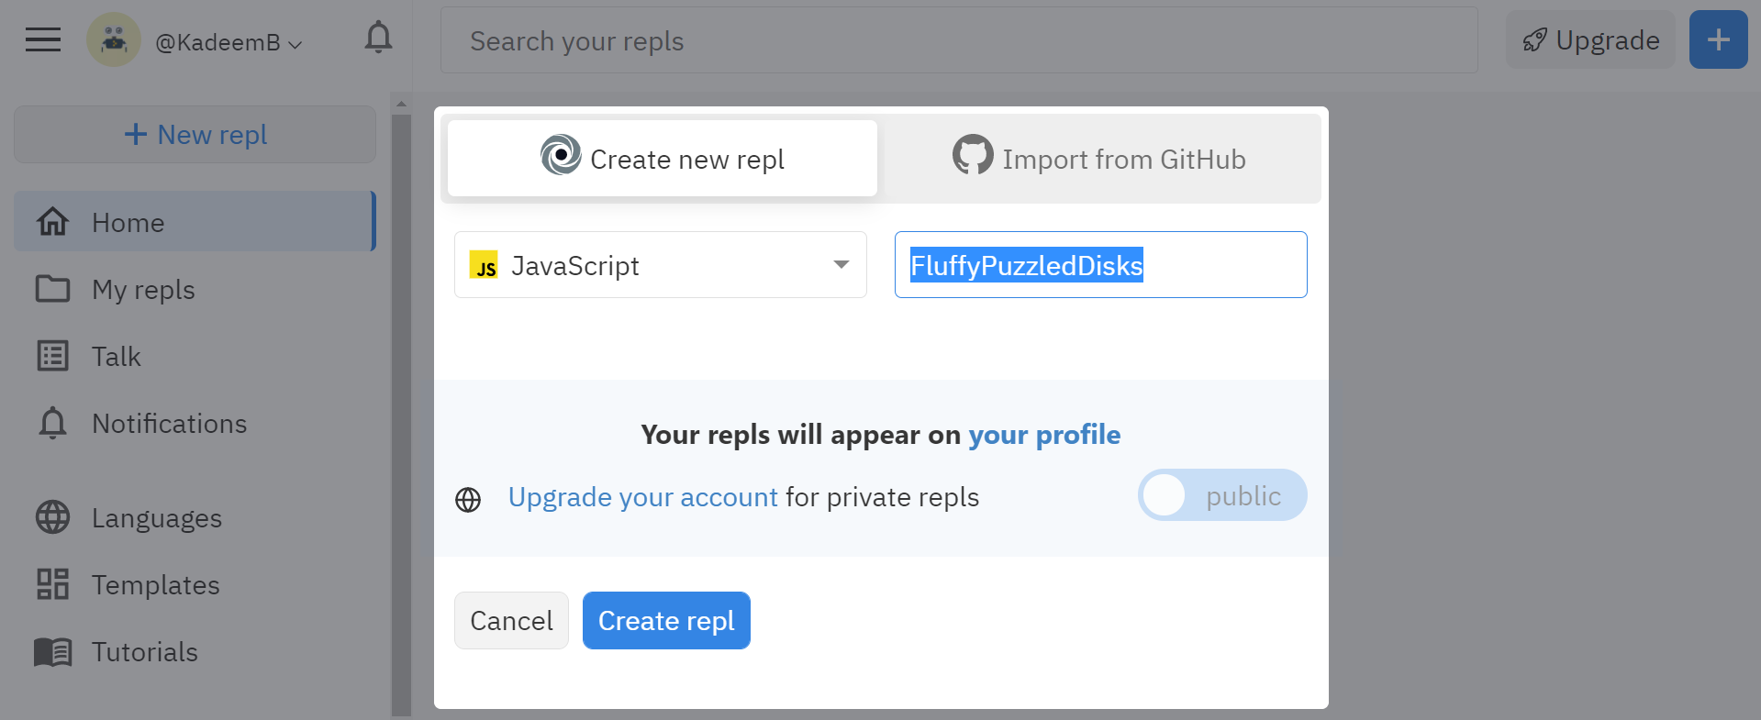
REPL.IT

Slide 10
OVERVIEW OF PROGRAMMING

Slide 11
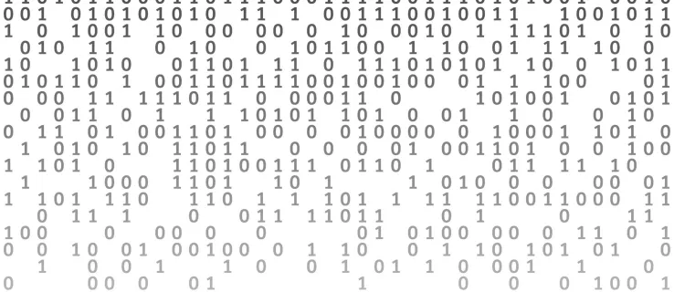
What some people think programming is?

Slide 12
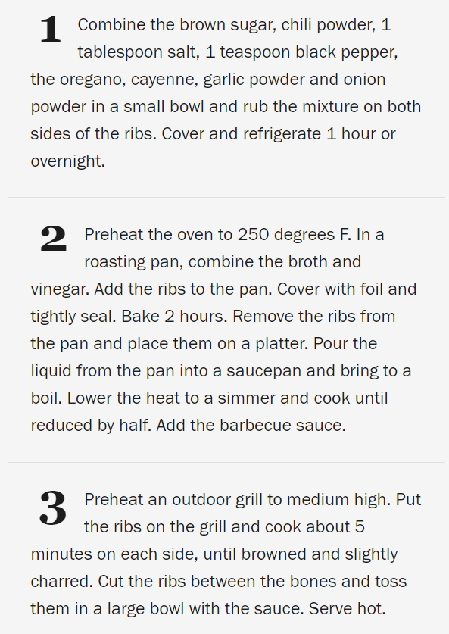
What programming actually is?
It’s like a recipe.
Writing a set of instructions/statements (written in a given programming language) to solve a problem

Slide 13
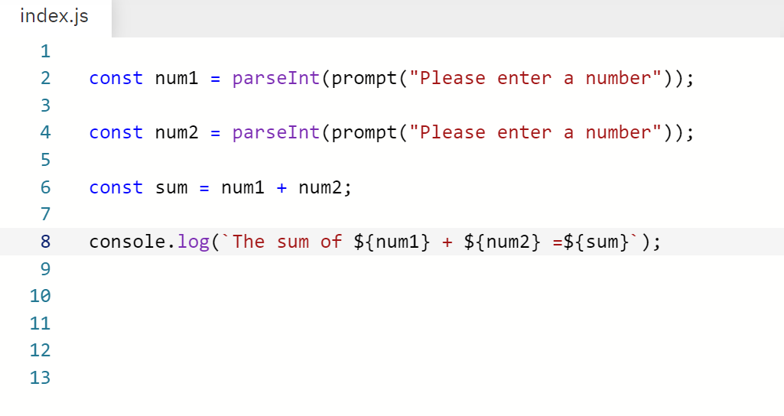
Programming languages have the concept of a statement.
A statement is a command that the programmer gives to the computer

Slide 14
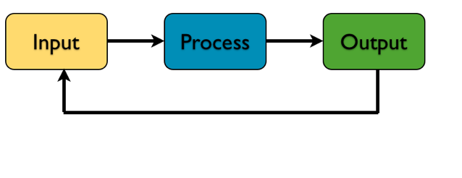
MAIN TYPE OF STATEMENTS IN PROGRAMMING

Slide 15
Exercise 1
Using Pseudo Code
Write a program to calculate the sum of two numbers?

Slide 16
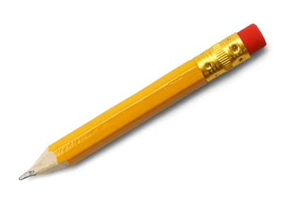
ANSWER SHEET
Ask the user to enter the first number
Capture the first number from the user and store it in memory.
Ask the user to enter the second number
Capture the second number from the user and store it in memory.
Calculate the sum (first number + second number)
Display the answer to the user.

Slide 17
Exercise 2
Using Pseudo Code
Write a program to find the area of a rectangle

Slide 18
ANSWER SHEET
Ask the user to enter the length of the rectangle -prompt
Capture the length from the user. -input
Ask the user to enter the width of the rectangle - prompt
Capture the width from the user. -input
Calculate the area (length * width) - processing
Output to the user. -output

Slide 19
PROGRAMMING FUNDAMENTALS
(Input, Output, Expressions,Operators)

Slide 20
INPUT

Slide 21
An input statement is a portion of a program that instructs a computer how to read data. It specifically pertains to gathering data from an input device.
prompt("Hi, what is your name");

Slide 22
OUTPUT

Slide 23
An output statement is a portion of a program that instructs a computer how to display information. It specifically pertains to sending information to an input device.
console.log("Programming using JavaScript");

Slide 24
EXPRESSIONS

Slide 25
An expression is any valid unit of code that resolves to a value.
Example of Arithmetic Expressions :
5 + 6
7- 9

Slide 26
ARITHMETIC OPERATORS

Slide 27
Arithmetic Operators
Operator | Symbol
Addition | +
Subtraction | -
Division | /
Multiplication | *
Modulus (Remainder operator) | %

Slide 28
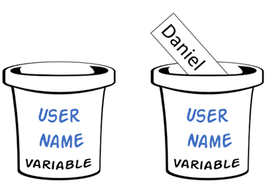
Variables
A variable is a name memory location that stores a single value of a particular type that can change

Slide 29
To Create a variable in JS(using ES6 syntax):
To Create a const in JS(using ES6 syntax):
let nameOfVariable;
const nameOfConstant=value;

Slide 30
Rules when naming variables
A variable name can ONLY consist of letters, numbers, the underscore(_), or the dollar sign ($) character. You can't use any other characters, symbols, and/or punctuation marks.
The first character must be a letter or an underscore (_). You can't use a number as the first character.
Variable names cannot contain spaces.
As with the rest of JavaScript, variable names are case sensitive.
There's no limit to the length of the variable name.
You can't use one of JavaScript's reserved words as a variable name.
Variables names must be unique. Two variable names cannot be the same name within the same scope.
Make your names descriptive and meaningful.

Slide 31
Simple Assignment Operator
=
To assign values to an operator, use the simple assignment operator ( = )
Example :
X = 5

Slide 32
COMMENTS
Comments are text notes added to the program to provide explanatory information about the source code. They are used in a programming languages to document the program and remind programmers of what tricky things they did with the code and also it helps other programmers to understand said logic for the maintenance of code.

Slide 33
JavaScript Data Types
Single Line Comment
// this is a comment
Multi-Line Comment
/*
This is a comment
*/

Slide 34
DATA TYPES
A data type is an attribute of data which tells the compiler or interpreter how the programmer intends to use the data. Most programming languages support several data types

Slide 35
JavaScript Data Types
Primitive Data Types
number
string “” ‘’ ``- template literals
boolean
undefined
null
symbol (new)
Reference Data Types (Object)
Array
Function
Object

Slide 36
Lab 1
Basic Sequential Programs
Lab Exercises

Slide 37
Control Constructs

Slide 38

What are Control Constructs ?

Slide 39
Control Constructs
Control Structures can be considered as the building blocks of computer programs. They determine when and which statements and/or commands are executed
The basic Control Structures in programming languages are:
Selection (Decision Making- Conditionals): which are used to execute one or more statements if a condition is met.
If
If else
If else if
Switch case
Iteration(loops): which purpose is to repeat a statement a certain number of times or while a condition is fulfilled.
For - When know how many times something is going to repeat
While
Do while

Slide 40
SELECTION CONSTRUCT
OR
CONDITIONALS

Slide 41


Slide 42
Conditionals
Often times a computer program must make choices on which way to proceed, e.g., if the ball is in bounds, do one thing, else, do something different
If the data has all been processed, end the program, else continue to the next data item... while the player has lives left continue the game.
Conditional statements, conditional expressions and conditional constructs are features of a programming language, which perform different computations or actions depending on whether a programmer-specified boolean condition evaluates to true or false

Slide 43
Types of Conditionals Constructs
if
If else
If else if
switch

Slide 44
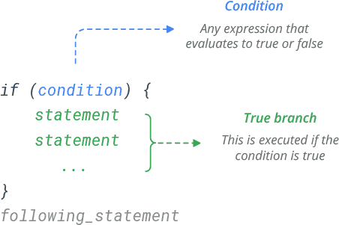

Slide 45
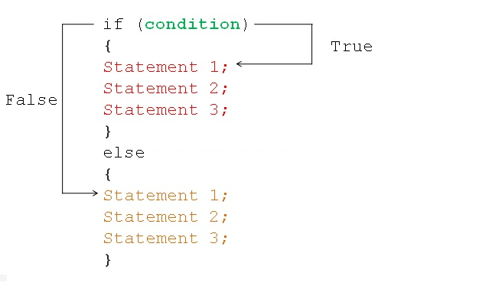

Slide 46
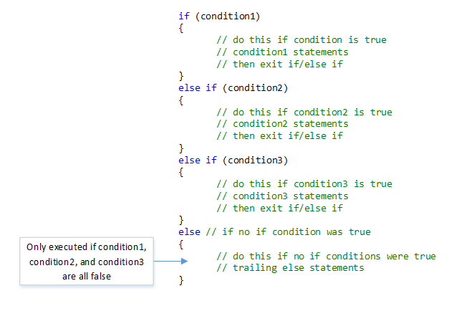
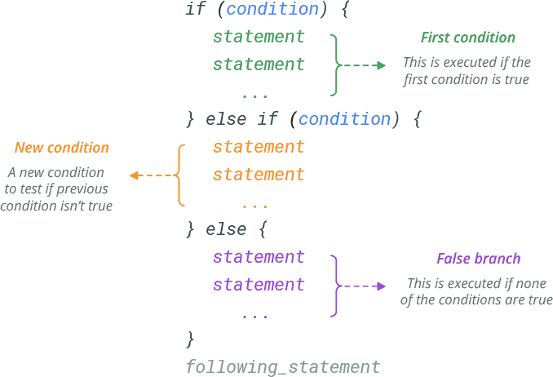

Slide 48
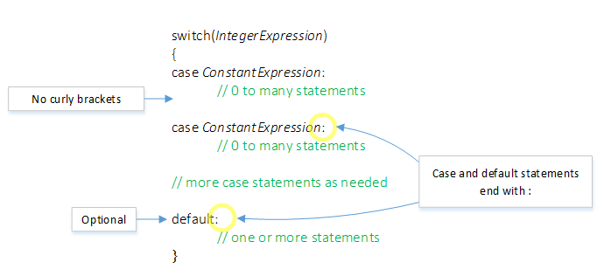

Slide 49
RELATIONAL OPERATORS

Slide 50
Relational Operators
Operator | Symbol
Less than | <
Less than or equal | <=
Greater than | >
Greater than or equal to | >=
Equal to | ==
Not equal to | !=

Slide 51
LOGICAL OPERATORS

Slide 52
Logical Operators
Operator | Symbol
Logical AND | &&
Logical OR | ||
NOT | !

Slide 53
Rules of Logical AND vs Logical OR
AND
OR
EX 1 | EX 2 | Result
T | T | T
T | F | F
F | T | F
F | F | F
EX 1 | EX 2 | Result
T | T | T
T | F | T
F | T | T
F | F | F

Slide 54
Lab 2
Selection and Decision Making Programs
Lab Exercises

Slide 55
ITERATION CONSTRUCT

Slide 56
Loops

Slide 57
Loops
Loops are among the most basic and powerful of programming concepts.
A loop in a computer program is an instruction(s) that repeats until a specified condition is reached.
In a loop structure, the loop asks a question. If the answer requires action, it is executed.

Slide 58
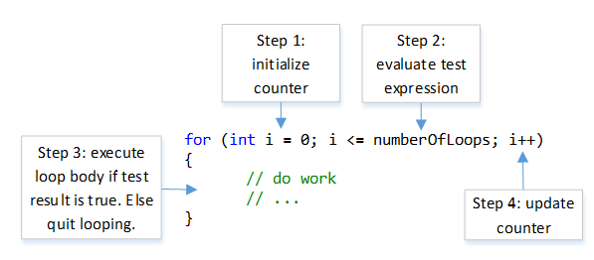
For Loop

Slide 59
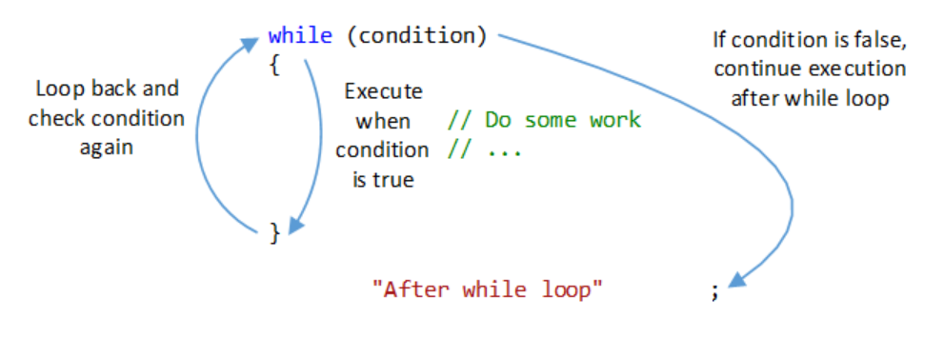
While Loop

Slide 60
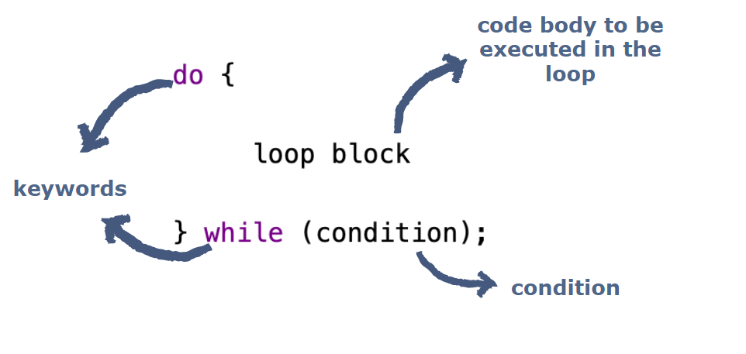
Do While

Slide 61
Keywords with loops
break- Break leaves the loop completely and executes the statements after the loop.
continue - continue leaves the current iteration and executes with the next value in the loop. break completely exits the loop

Slide 62
Lab 3
Iteration/Loops
Lab Exercises

Slide 63
FUNCTIONS

Slide 64
Functions
What is a function?
Functions are a block of code that performs a specific task.
A collection of statements that performs a certain task
Why do need functions?
Functions break a complex program into smaller, manageable pieces.
Function reduce repetition in your code and increase reusability
Organize your code into more manageable pieces

Slide 65
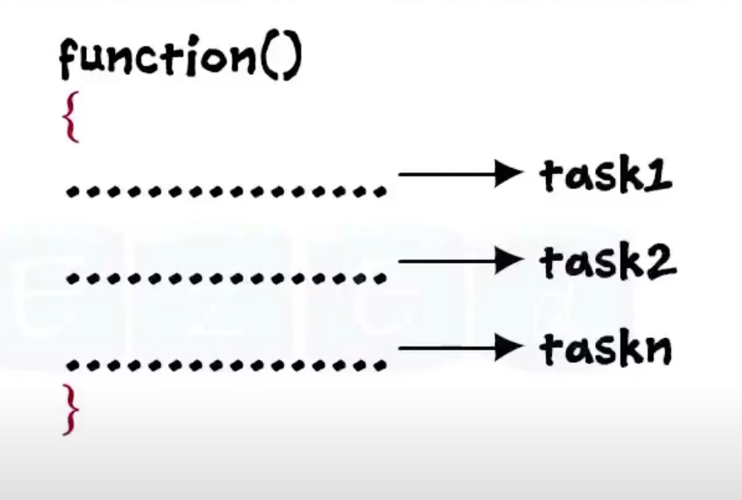
Functions contain statements
Functions contain a set of statements to explain what the function should do.

Slide 66
Creating Functions
How to create a method?
Methods have 3 parts:
Definition
Body

Slide 67
Creating A Function Declaration
How to create a function ?
Functions have 3 parts:
Definition
Body
Function signature
function sayHello(lang)
{ if (lang=="English") { console.log("Hello!"); } else if (lang=="French") { console.log("Bonjour!"); }
}
Function body

Slide 68
Return types
There are 2 types of functions:
Functions that don’t return a value
value-returning functions
Function that don’t return a value:
Performs a task and exits (terminates)
Value returning functions:
Performs a task and send a value back to the code that called the function

Slide 69
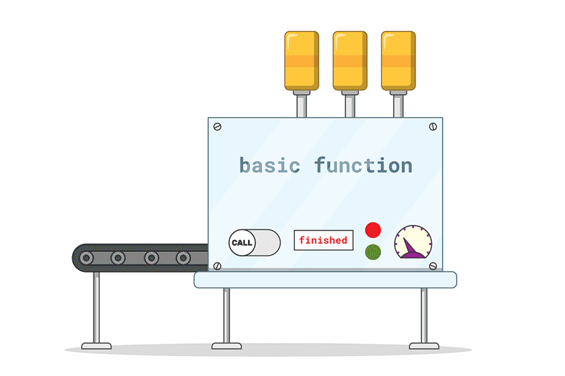
Function that don’t return a value
Performs a task and exits (terminates)

Slide 70
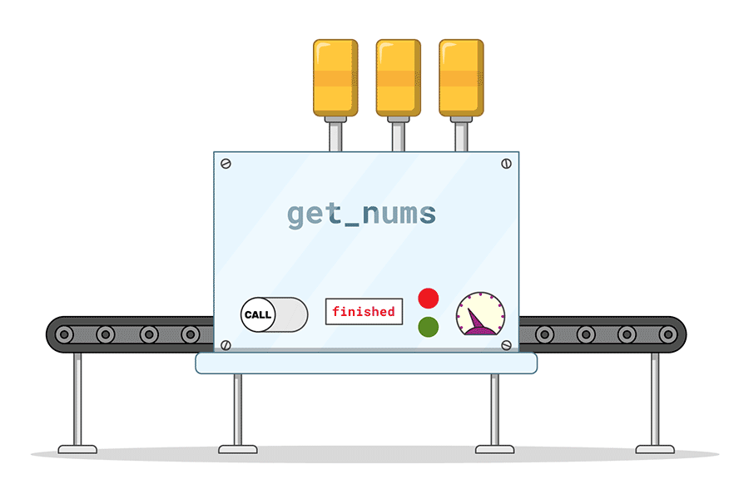
Value returning functions
Performs a task and send a value back to the code that called the function

Slide 71
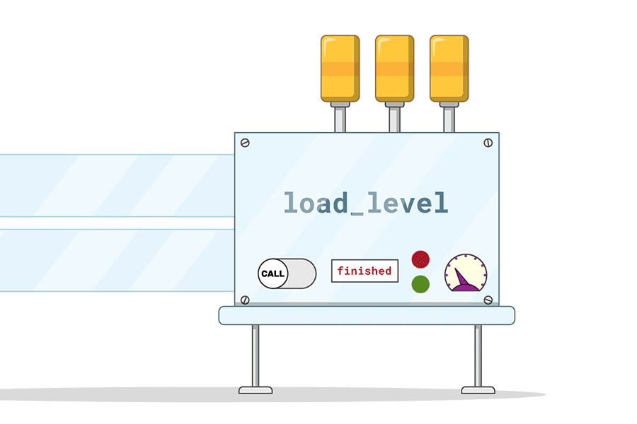
Functions can accept parameters
Parameters are “inputs” that you provide to the function
The function uses the “inputs” to complete its task.

Slide 72
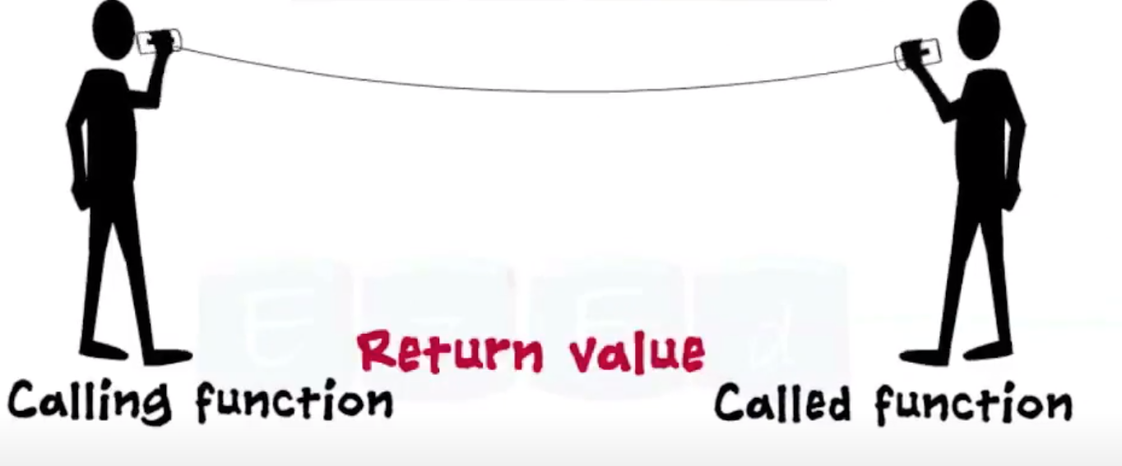
Using a function
To use a function, you need to call it

Slide 73
Lab 4
Functions
Lab Exercises

Slide 74
ARRAYS

Slide 75
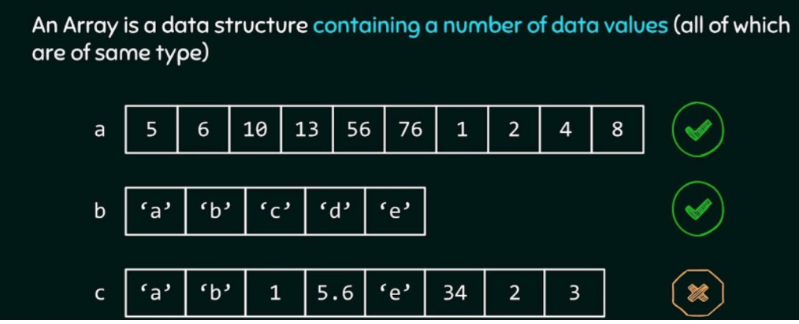
Arrays
Arrays are data structure (objects) that store several values.
In some programming languages arrays have a fixed length and they can only store values of a particular type

Slide 76
Arrays
In JavaScript, arrays are not fixed in length.
In JavaScript, arrays can values of varying type.

Slide 77
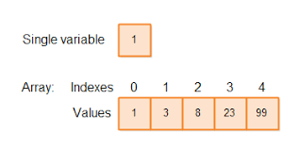

Slide 78
Lab 5
Arrays
Lab Exercises

Slide 79
THE END

